Slide 1


CNN 및 딥러닝 기초
Natural Language Processing & AI Lab., Korea University

Slide 2
Machine Learning Overview

Slide 3
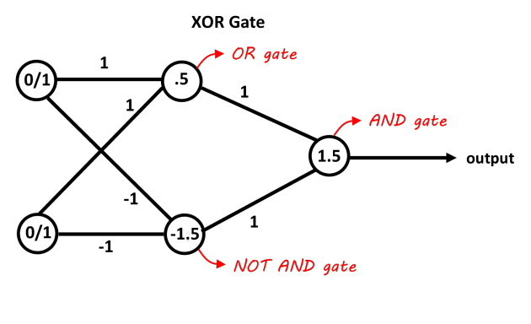
Neural Networks
Transforms input to output
NN is a “set of weights(parameters)”
Need to change the weights(train) to make it do what we want
Inputs
Weights

Slide 4

Neural Networks
Very complex transformations (functions) can be approximated using NNs
Cat
Cat

Slide 5
How to Train a NN
With loss and gradient
Forward Pass
Prediction
(Output)
Label
“Duck”
Loss
“Cat”
Weight Update
Input
Gradient
Backward Pass

Slide 6

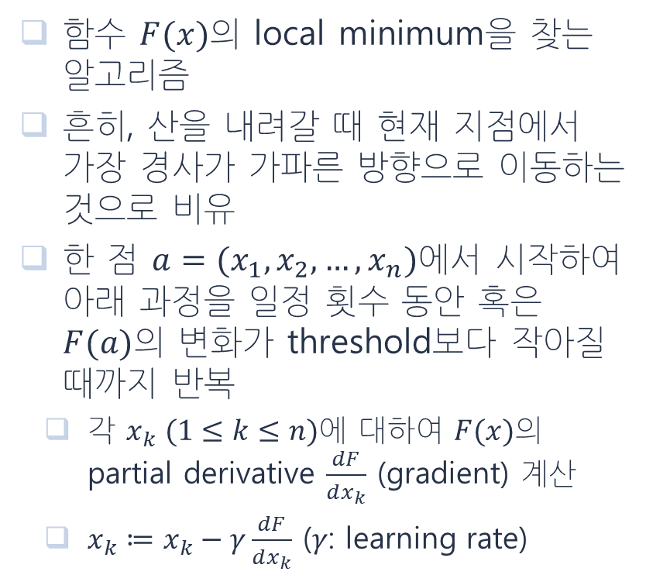
Gradient Descent Algorithms
함수 $F(x)$의 local minimum을 찾는 알고리즘
흔히, 산을 내려갈 때 현재 지점에서 가장 경사가 가파른 방향으로 이동하는 것으로 비유
한 점 $a=(x_{1},x_{2}, …,x_{n})$에서 시작하여 아래 과정을 일정 횟수 동안 혹은 $F(a)$의 변화가 threshold보다 작아질 때까지 반복
각 $x_{k} (1≤k≤n)$에 대하여 $F(x)$의 partial derivative $\frac{dF}{dx_{k}}$ (gradient) 계산
$x_{k}≔x_{k}−γ\frac{dF}{dx_{k}}$ ($γ$: learning rate)

Slide 7
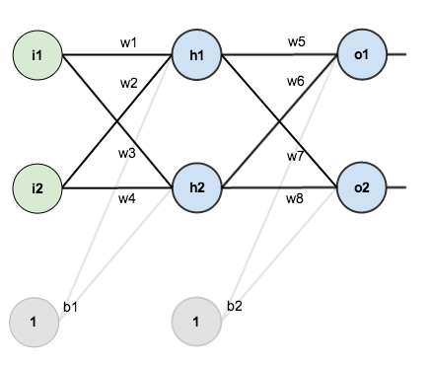
Backpropagation Step-by-Step
https://mattmazur.com/2015/03/17/a-step-by-step-backpropagation-example/

Slide 8
Key Components of NN
Input and label: these forms a “dataset”
Neural network model
…
Dataset
Model
Prediction
(Output)
Label
“Duck”
Loss
“Cat”
Input

Slide 9

Types of NN Model
Almost all neural network models can be classified into one of the followings

Slide 10
Things to Consider
How to acquire the needed dataset – All machine learning methods require data
Unsupervised ≠ no data (or label) needed
Unsupervised = label can be generated w/o human labor (much cheaper than supervised data)
Unsupervised training usually yields much lower performance, or is not possible
What model to use
Many public models available
Usually less important than dataset – garbage in, garbage out!

Slide 11
The Dataset
Fashion-MNIST

Slide 12
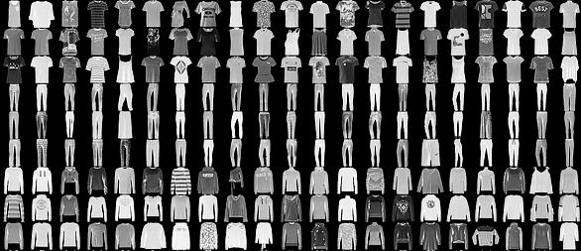
Fashion-MNIST
Like the famous MNIST, but with fashion images

Slide 13
Fashion-MNIST
Same number of samples (60,000 train, 10,000 test) and classes (10), same resolution grayscale images
Task: categorize each image into one of 10 classes - T-shirt/top, Trouser, Pullover, Dress, Coat, Sandal, Shirt, Sneaker, Bag, Ankle boot
https://github.com/zalandoresearch/fashion-mnist

Slide 14
Perceptrons
The most basic form of ANN

Slide 15
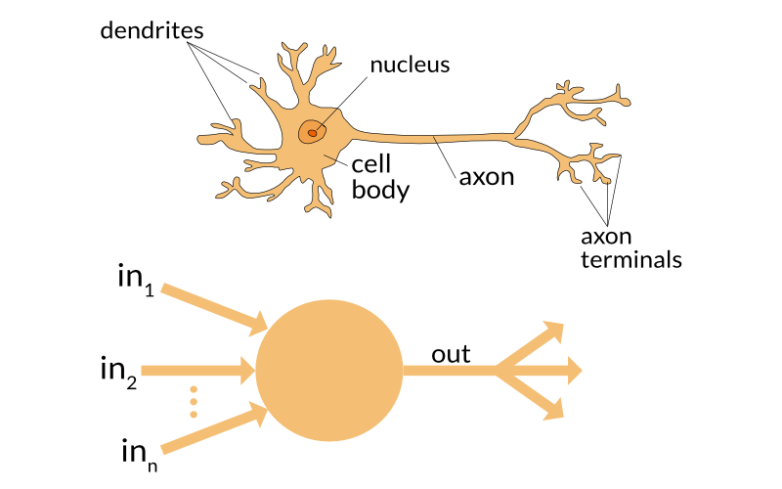
Neurons and Perceptrons
Artificial Neural Networks(ANN) were inspired by the central nervous system of humans
ANN’s are built upon simple signal processing elements that are connected together into a large mesh

Slide 16
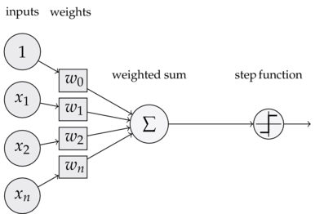
Perceptrons
Just like a biological neuron has dendrites to receive signals, a cell body to process them, and an axon to send signals out to other neurons, the artificial neuron has a number of input channels, a processing stage, and one output that can fan out to multiple other artificial neurons

Slide 17
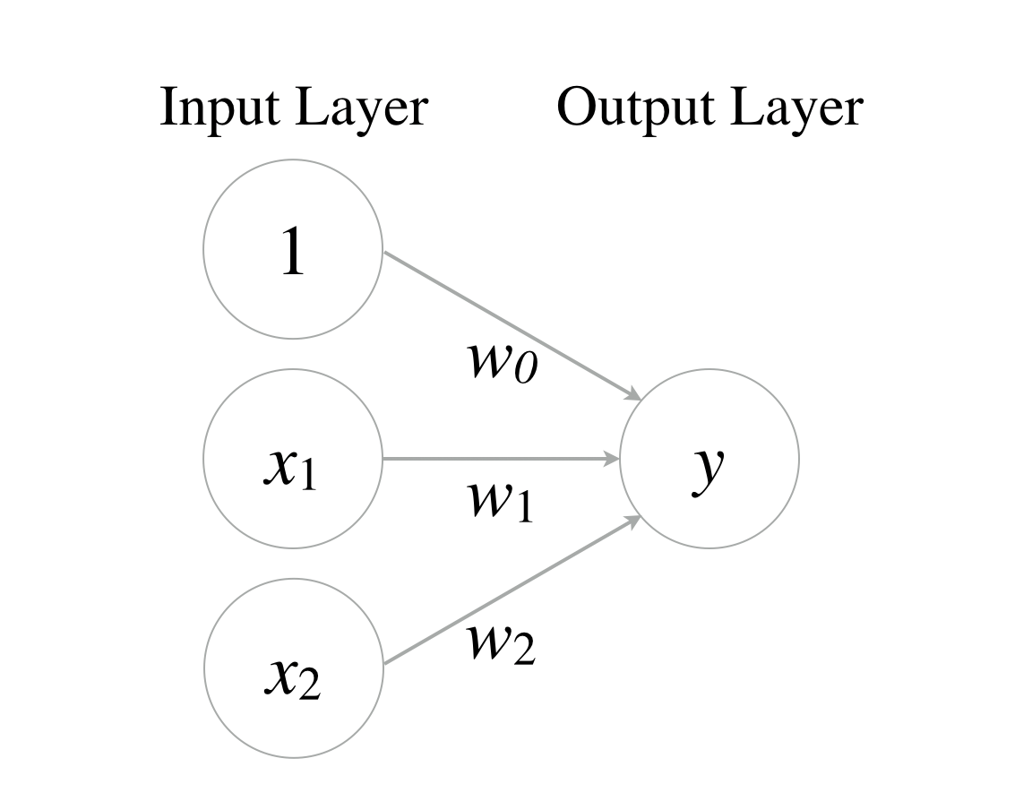
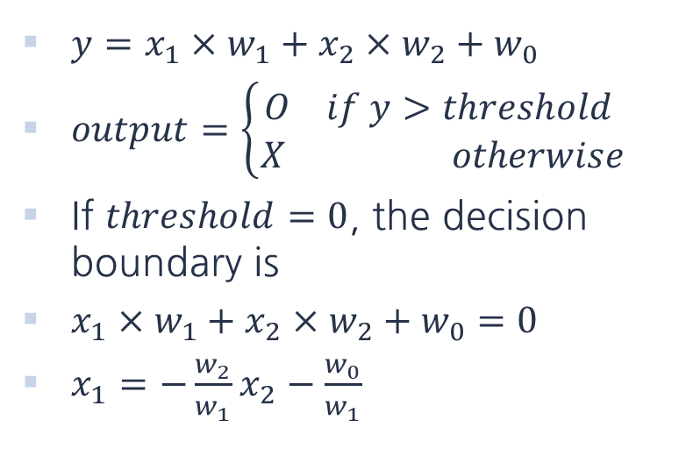
Perceptrons
$y=x_{1}×w_{1}+x_{2}×w_{2}+w_{0}$
$output=\left\{\begin{aligned}O if y>threshold \\ X otherwise\end{aligned}\right.$
If $threshold=0$, the decision boundary is
$x_{1}×w_{1}+x_{2}×w_{2}+w_{0}=0$
$x_{1}=−\frac{w_{2}}{w_{1}}x_{2}−\frac{w_{0}}{w_{1}}$

Slide 18
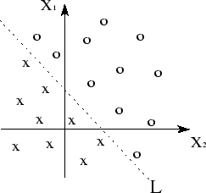
Linearly Separable
$y=x_{1}×w_{1}+x_{2}×w_{2}+w_{0}$
$output=\left\{\begin{aligned}O if y>threshold \\ X otherwise\end{aligned}\right.$
If $threshold=0$, the decision boundary is
$x_{1}×w_{1}+x_{2}×w_{2}+w_{0}=0$
$x_{1}=−\frac{w_{2}}{w_{1}}x_{2}−\frac{w_{0}}{w_{1}}$

Slide 19
Logic Gates with a Perceptron
Can we implement basic logic gates using perceptrons?
X1 | X2 | Y(AND) | Y(OR) | Y(XOR)
0 | 0 | 0 | 0 | 0
0 | 1 | 0 | 1 | 1
1 | 0 | 0 | 1 | 1
1 | 1 | 1 | 1 | 0

Slide 20
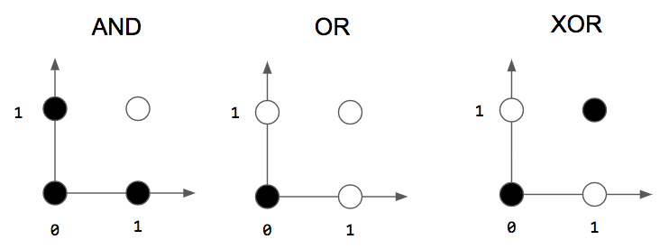
Logic Gates with a Perceptron
Can we implement basic logic gates using perceptrons?

Slide 21
Logic Gates with a Perceptron
Can we implement basic logic gates using perceptrons?

Slide 22
XOR Problem
It is impossible to implement XOR gate with a perceptron
?

Slide 23
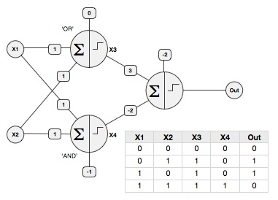
XOR Problem
It is possible with two layers of perceptrons
Using another perceptron that aggregates the outputs of AND, OR gates (also implemented with perceptrons)
Multi-layer Perceptron(MLP)

Slide 24
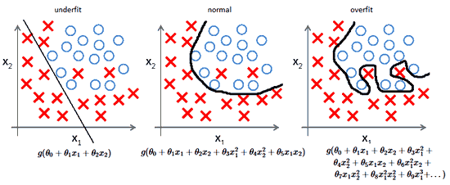
Adding Layers to Network
Adding more layers to neural networks has an effect of making the decision boundary more complex
Mis-selecting number of layers can lead to under/over fitting

Slide 25
Vanishing Gradient Problem

Slide 26
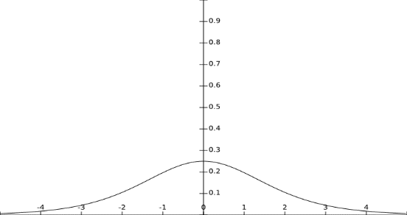
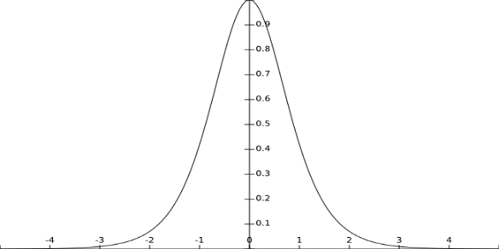
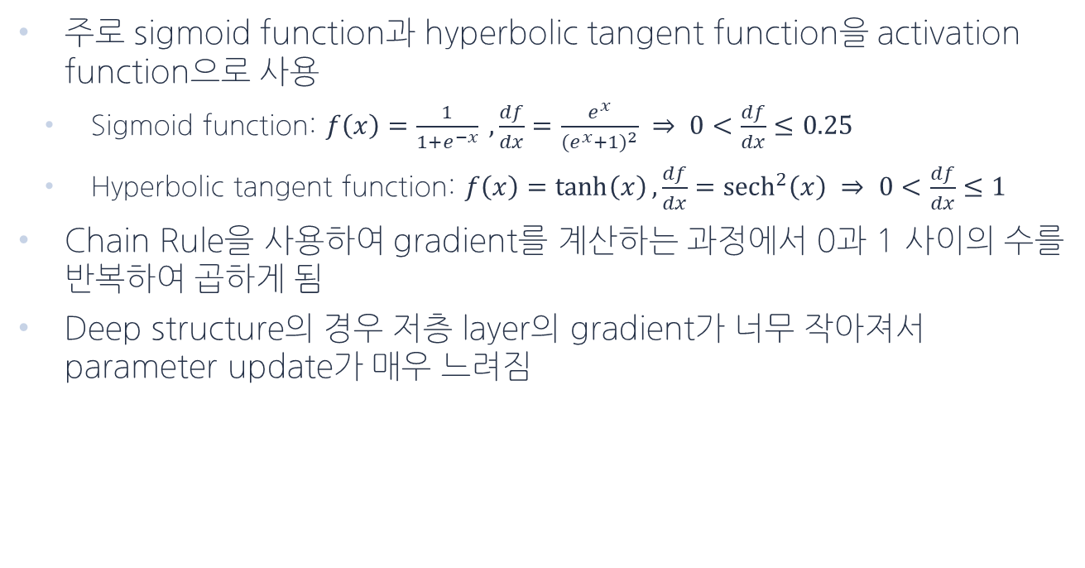
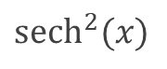
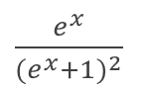
Problem
주로 sigmoid function과 hyperbolic tangent function을 activation function으로 사용
Sigmoid function: $f\left(x\right)=\frac{1}{1+e^{−x}} , \frac{df}{dx}=\frac{e^{x}}{{(e^{x}+1)}^{2}} ⇒ 0<\frac{df}{dx}≤0.25$
Hyperbolic tangent function: $f\left(x\right)=\tanh\left(x\right), \frac{df}{dx}={sech}^{2}\left(x\right) ⇒ 0<\frac{df}{dx}≤1$
Chain Rule을 사용하여 gradient를 계산하는 과정에서 0과 1 사이의 수를 반복하여 곱하게 됨
Deep structure의 경우 저층 layer의 gradient가 너무 작아져서 parameter update가 매우 느려짐
$\frac{e^{x}}{{(e^{x}+1)}^{2}}$
$${sech}^{2}(x)$$

Slide 27
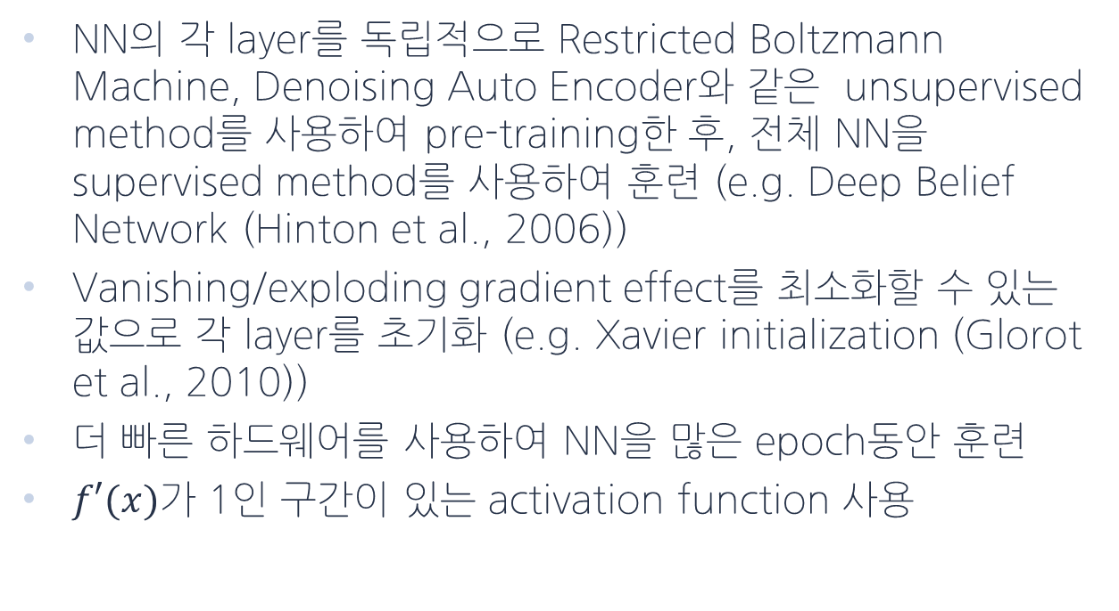
Solution
NN의 각 layer를 독립적으로 Restricted Boltzmann Machine, Denoising Auto Encoder와 같은 unsupervised method를 사용하여 pre-training한 후, 전체 NN을 supervised method를 사용하여 훈련 (e.g. Deep Belief Network (Hinton et al., 2006))
Vanishing/exploding gradient effect를 최소화할 수 있는 값으로 각 layer를 초기화 (e.g. Xavier initialization (Glorot et al., 2010))
더 빠른 하드웨어를 사용하여 NN을 많은 epoch동안 훈련
$f′(x)$가 1인 구간이 있는 activation function 사용

Slide 28
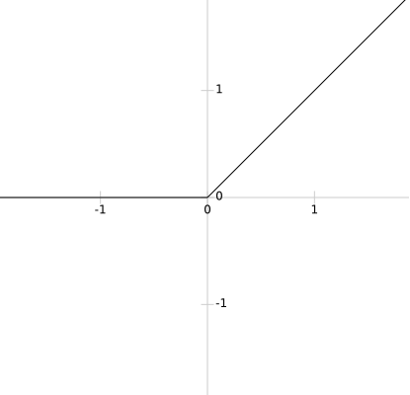
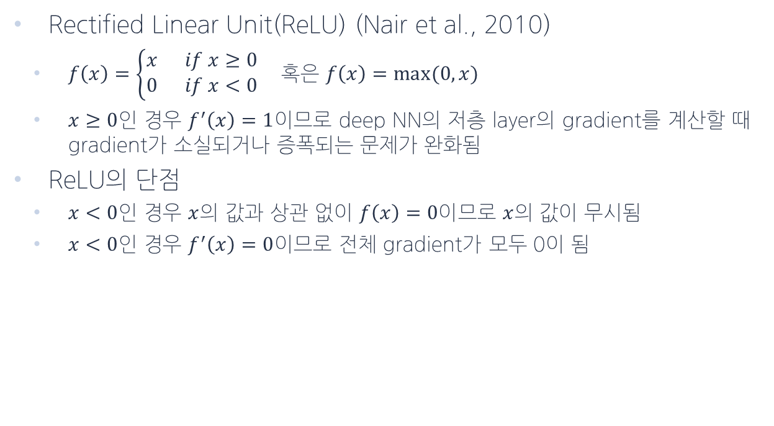
Rectified Linear Units
Rectified Linear Unit(ReLU) (Nair et al., 2010)
$f\left(x\right)=\left\{\begin{aligned}x if x≥0 \\ 0 if x<0\end{aligned}\right.$ 혹은 $f\left(x\right)=max⁡(0,x)$
$x≥0$인 경우 $f^{′}\left(x\right)=1$이므로 deep NN의 저층 layer의 gradient를 계산할 때 gradient가 소실되거나 증폭되는 문제가 완화됨
ReLU의 단점
$x<0$인 경우 $x$의 값과 상관 없이 $f\left(x\right)=0이$므로 $x$의 값이 무시됨
$x<0$인 경우 $f^{′}\left(x\right)=0$이므로 전체 gradient가 모두 0이 됨

Slide 29
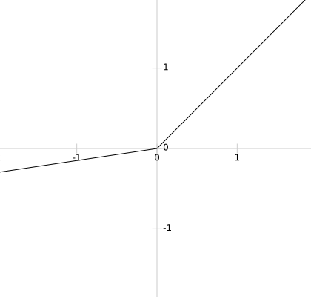
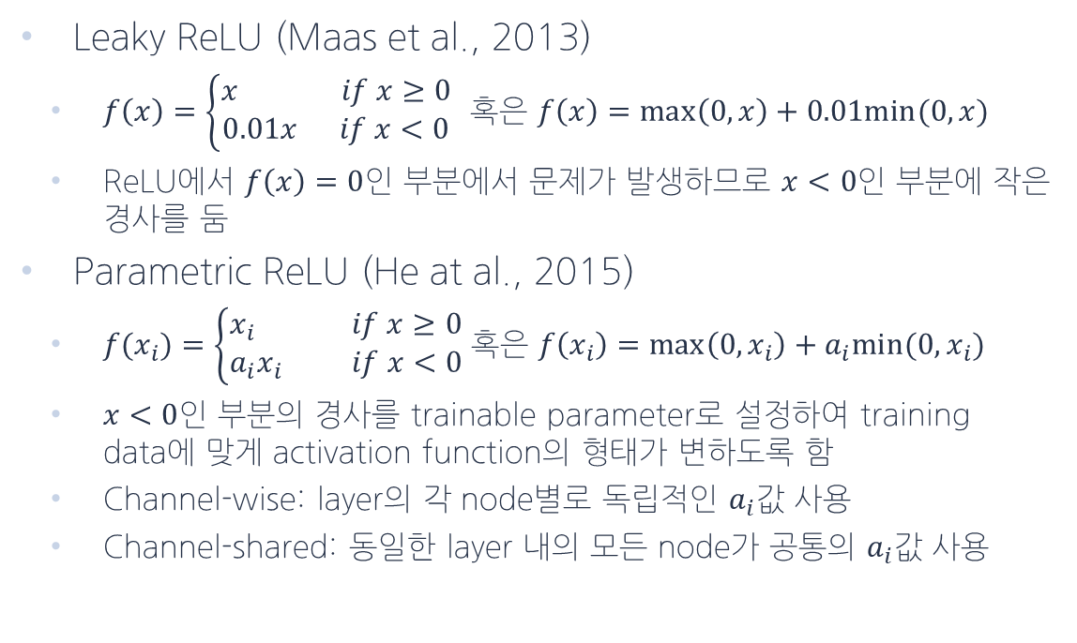
ReLU의 변형
Leaky ReLU (Maas et al., 2013)
$f\left(x\right)=\left\{\begin{aligned}x if x≥0 \\ 0.01x if x<0\end{aligned}\right.$ 혹은 $f\left(x\right)=\max\left(0,x\right)+0.01min⁡(0,x)$
ReLU에서 $f\left(x\right)=0$인 부분에서 문제가 발생하므로 $x<0$인 부분에 작은 경사를 둠
Parametric ReLU (He at al., 2015)
$f(x_{i})=\left\{\begin{aligned}x_{i} if x≥0 \\ a_{i}x_{i} if x<0\end{aligned}\right.$ 혹은 $f\left(x_{i}\right)=\max\left(0,x_{i}\right)+a_{i}min⁡(0,x_{i})$
$x<0$인 부분의 경사를 trainable parameter로 설정하여 training data에 맞게 activation function의 형태가 변하도록 함
Channel-wise: layer의 각 node별로 독립적인 $a_{i}$값 사용
Channel-shared: 동일한 layer 내의 모든 node가 공통의 $a_{i}$값 사용

Slide 30
Convolutional Neural Network Model

Slide 31

Convolution
1 | 0 | 1
0 | 1 | 0
1 | 0 | 1
Kernel
(3x3)
Convolved Feature
Image
Mainly used for image processing
Filter matrix value multiplied by the pixel value of the image.

Slide 32
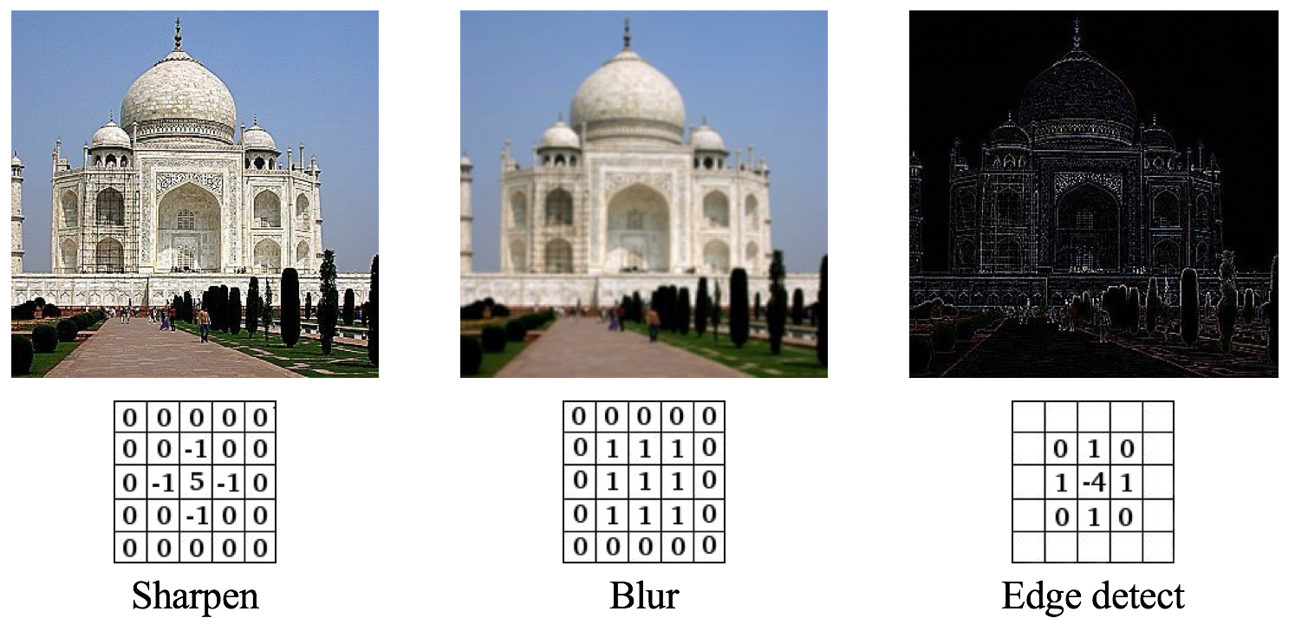
Convolution
Depending on the value of the filter, the image can have various effects.
Notes:
Filter의 값에 따라 sharpen, blur, edge detect등 이미지에 다양한 효과를 줄 수 있다.

Slide 33
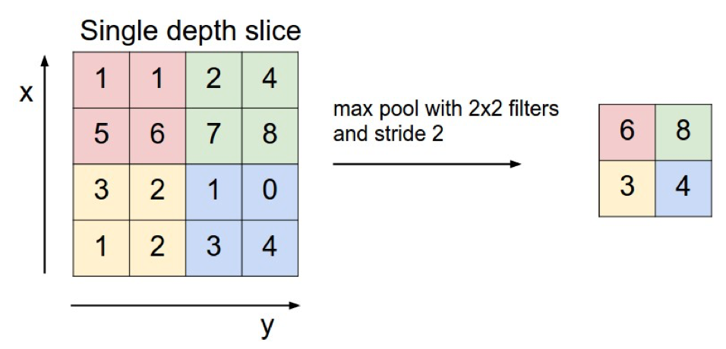
Pooling
Reduce the size of the feature
The most commonly used max pooling preserves only the maximum value of the values in the filter.

Slide 34

Convolutional Neural Network(CNN)
Extract features through convolution and pooling
Generally hundreds to thousands of filters (kernels) are used
It has mainly been applied to image processing, but it is also applied to NLP task recently.

Slide 35
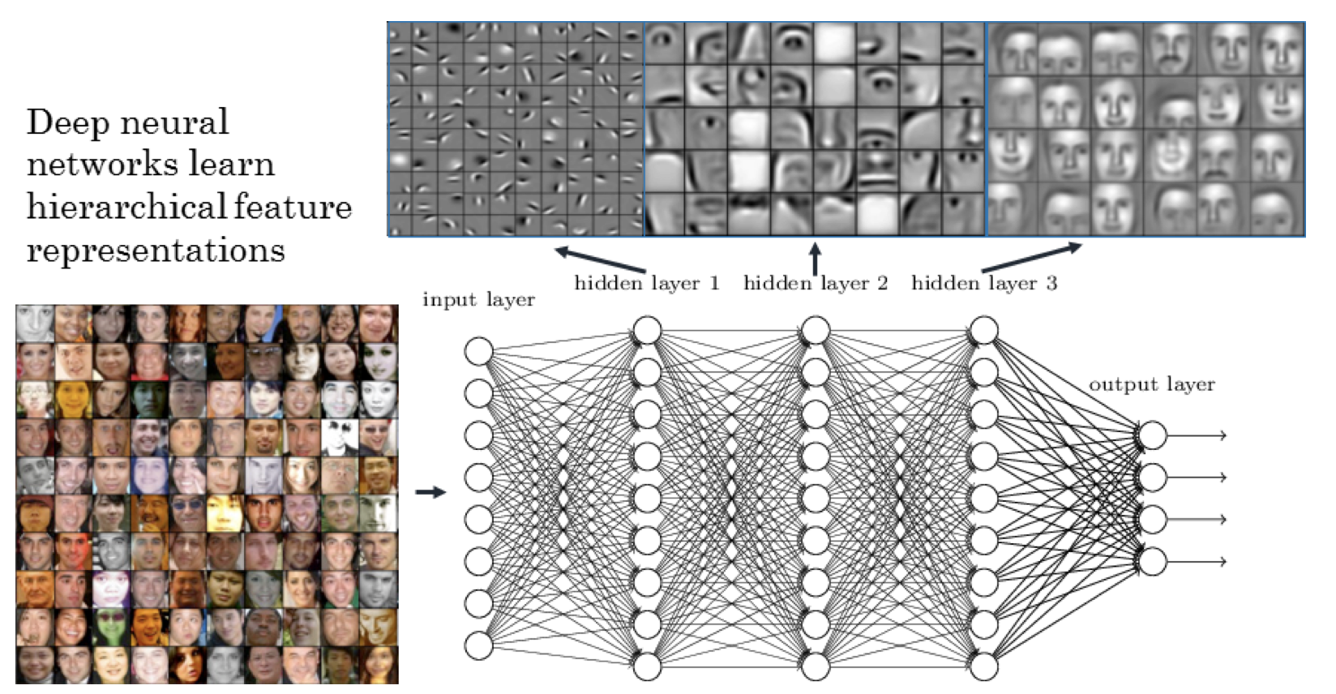
Convolutional Neural Network(CNN)

Slide 36
More Techniques
Early Stopping, Dropout, Training with Momentum

Slide 37
Under/Over Fitting and Model Complexity
Underfitting – model is too simple for the dataset
Overfitting – model is too complex for the dataset

Slide 38
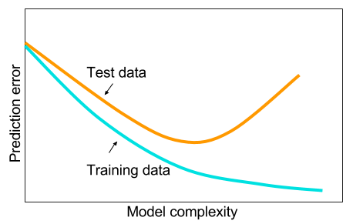
Under/Over Fitting and Model Complexity
Underfitting – model is too simple for the dataset
Overfitting – model is too complex for the dataset

Slide 39
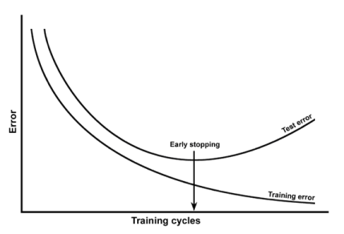
Under/Over Fitting and Training Iterations
Underfitting – model can improve from more training iterations
Overfitting – model is “memorizing” the dataset, instead of generalizing to it

Slide 40
Early Stopping
Monitor the test/validation error, and stop training when test/validation error starts to increase

Slide 41
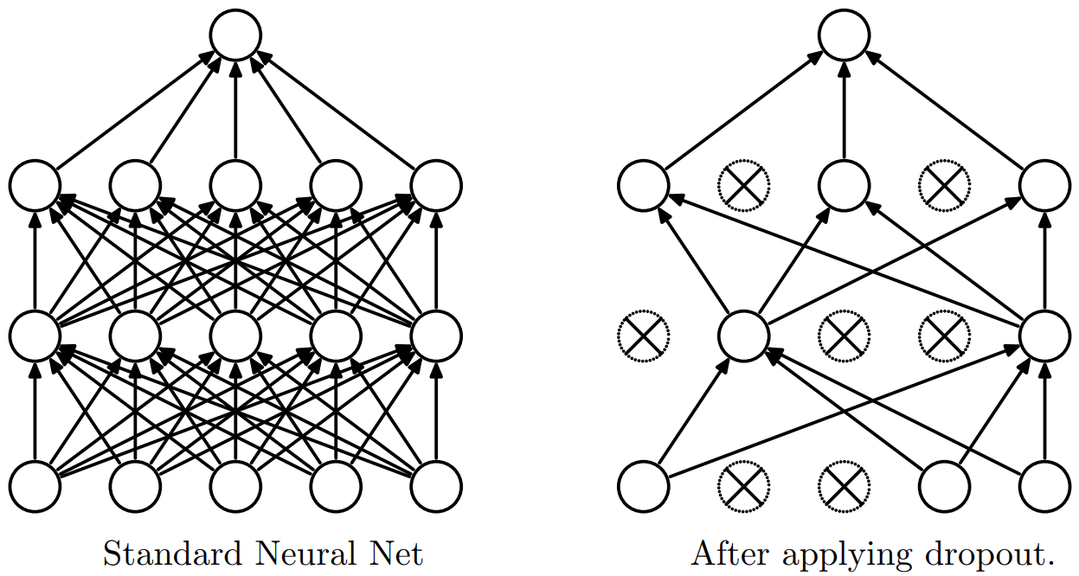
Dropout
A Simple Way to Prevent Neural Networks from Overfitting
Randomly dropout (i.e. set to zero) nodes of a network
Reduces the model complexity
Ensemble of possible models

Slide 42

Training with Momentum
Vanilla gradient descent is slow and can settle in saddle points
Solution - gradient descent with momentum

Slide 43
THANKS!
Any questions?

